Slide 1
Japanese Picture Brides
5 July 2011

Slide 2
Why did Japanese men come to the US?
Work for money, save and return to Japan
pay off fathers’ debts
become an adopted son
Escape the draft

Slide 3
Male Workers in the US
Contract labor
Canneries
Railroads
Mines
Logging
Farms

Slide 4
Need Somebody to Love
11:3

Slide 5
Need Somebody to Love
33:1

Slide 6
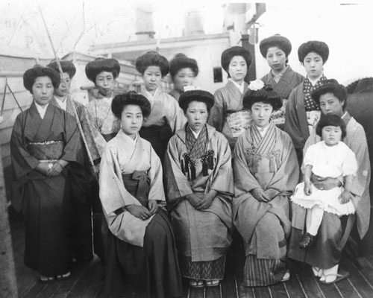
The Picture Bride System
Mai Kekkon-Arrange Marriage
Nakodo-Middle person/go between
Family relationships between future groom and bride
Pictures
Japanese Picture Brides in San Francisco

Slide 7
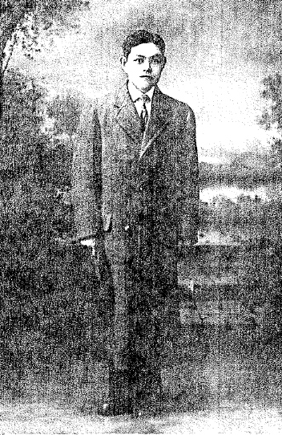
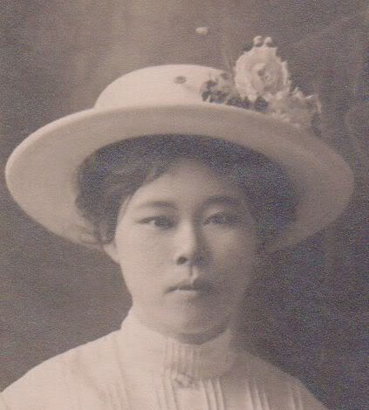
Zenkichi Kikuchi
Mrs. Kou Kitano, 1914

Slide 8
Why Did They Immigrate?
Family
Captivating (misleading) stories of the US
Financial reasons

Slide 9
The Gentleman’s Agreement 1907
San Francisco Board of Education declares separation of Japanese students from public schools
Roosevelt states this was “wicked absurdity”
Negative responses

Slide 10
The Gentleman’s Agreement 1907
to alleviate the perceived (if unjustified) root cause by restricting the immigration of Japanese laborers to the United States;
to placate the Japanese so that cordial relations between the two countries could resume; and,
to prepare the U.S. Navy for possible action if hostilities escalated (several war scares erupted during the negotiations)

Slide 11
The Gentleman’s Agreement 1907
Families of Japanese inside the United States at the creation of the Gentleman’s Agreement could STILL immigrate to the United States
20,000 picture brides came between 1907 and 1908

Slide 12
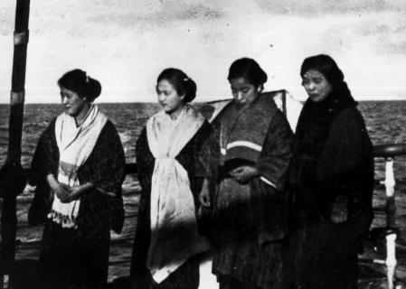
Journey
Passport
Copy of husband’s family registration
Health Certificate
Physical Examinations
Trachoma
Hookworm
Syphilis
Documents would take a long time to go through the system
http://www.jccc.on.ca/heritage/five_gen/exhibit/images/01/b03_large.gif

Slide 13
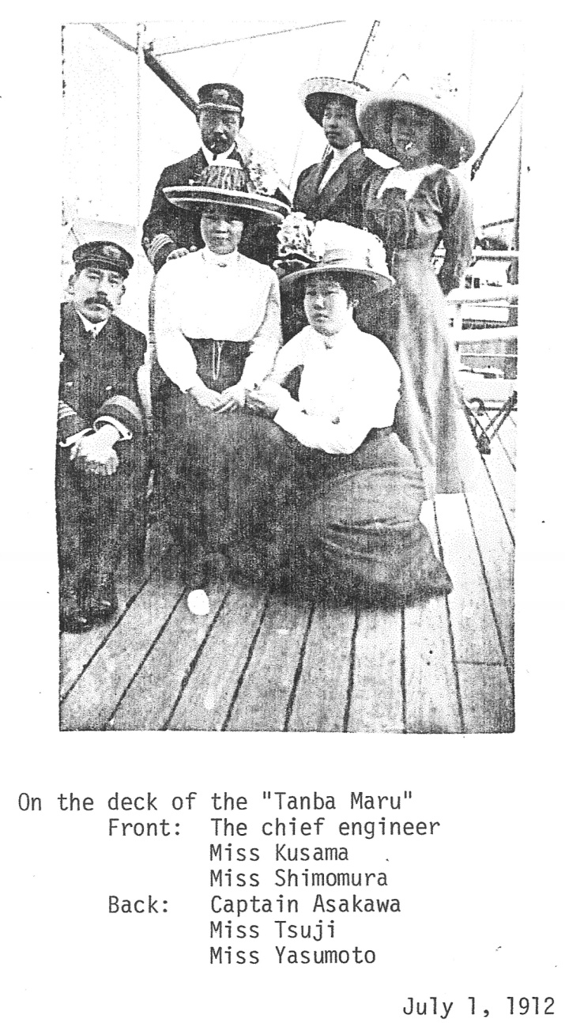
Journey
Exploited by collaboration between doctors and lodgers
Journey would take weeks
Distress during the voyage
Married on the boat or port

Slide 14
Life When They Arrived
Problems
Men were not exactly what they described themselves
Younger in pictures
Claimed to be wealthier
Treated as commodities
Sold to other men
Sold into prostitution
Harsh living conditions

Slide 15
Life When They Arrived
Solutions
Some women (who had the money) went back to Japan
Some left their husbands and found new ones
Most stayed with their husbands regardless of any untruthfulness

Slide 16
Life After Arrival
Economic Oppression
Cultural Oppression
Sexual Oppression
Racial Oppression
Farming
Family
Housework
Notes:
-No midwives
-custom to have months for rest
-only had a week or less
-no midwife
-Racism

Slide 17
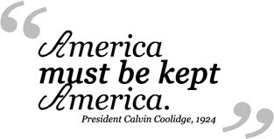
The End of the Picture Bride in the United States

Slide 18
Major Stereotype
That Japanese Picture Brides were submissive
“I was the perfect, filial daughter, and obedient wife, and sacrificing mother.”
BUT
Many came to the US and Hawaii against their parents’ wishes
Many started their own businesses without the consent of their husbands and help from their children

Slide 19
Reflection
Many picture brides feel “positively” about their lives when asked
Why?
Not having to care for their husband’s mother
Forms of female solidarity
Friendships
Women’s groups
Memories of the strengths of their mother and grandmother
Religion

