Slide 1
To America…
19 July 2011

Slide 2
Imperialism
"the creation and maintenance of an unequal economic, cultural and territorial relationship, usually between states and often in the form of an empire, based on domination and subordination”
-Wikipedia

Slide 3
Chinese to the United States

Slide 4
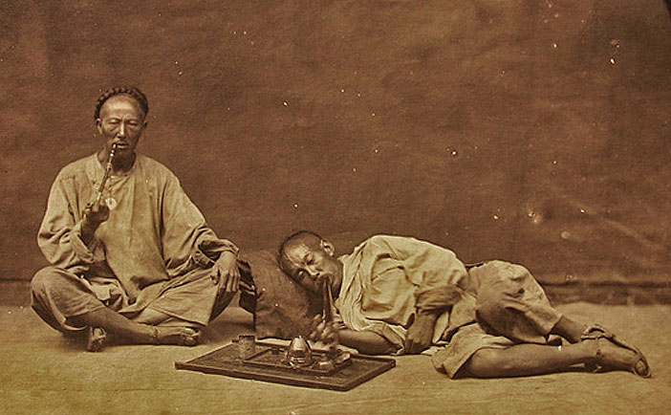
The Opium Wars

Slide 5
Treaty of Nanjing 1842
China had to reimburse Britain for invading it
Ports were opened
Hong Kong
Extraterritoriality
the state of being exempt from the jurisdiction of local law, usually as the result of diplomatic negotiations

Slide 6
Economic Oppression and Political Instability
Chinese upset with government
Heavy Taxes
Rebellions
Notes:
-Guangdong- exports increased (opium, cotton)
-Imperial government in China could do little to counter this, so they had to tax
-Opium wars, China agrees to pay western powers to open ports
-taxing leads to peasant rebellions, local economy is disrupted

Slide 7
Japanese to the United States

Slide 8
Notes:
Feudal Japan-foreign immigration prohibited
1853-US sent Commodore Matthew Perry to seek treaties with Japan
Fall of the Edo Period
Start of the Meiji Period/Restoration in 1868
Modernization

Slide 9
Why did Japanese men come to the US?
Chinese Exclusion Act 1882
Russo-Japanese War 1904-1905
Notes:
1884-Japan allows immigration to Hawaii and California
Russo-Japanese War puts Japan in an economically weaker state
-Japan tells men to go overseas and work, get money and
Chinese Exclusion Act of 1882

Slide 10
Why did Japanese men come to the US?
Work for money, save and return to Japan
pay off fathers’ debts
become an adopted son
Escape the draft

Slide 11
Filipinos to the United States

Slide 12
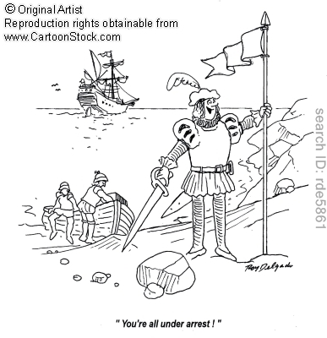
The Conquistador

Slide 13
Spanish-American War1898
Notes:
US people want Cuba
USS Maine to Havana to protect American residents in Cuba during revolution in Cuba
-1888-the USS Maine blew up killing 266 sailors
-US declares it was a outside source that destroyed the ship
-Spanish said it was internal
President McKinley demands that Spain give up Cuba and grant Cuban independence under US supervision
Spanish American war begins in April of 1898
-War in Cuba only last four months
-San Juan hill-charge famous
In the Philippines
-revolution against Spain in Philippines
-assassination of McKinley
-it was the Cubans and Filipino insurgents who were really destroying Spain

Slide 14
US Imperialism
Betrayal
Secret meeting between US and Spain
Spain surrender with terms that Filipinos don’t take over Manila and US gets control of the Philippines
Sparked the US-Philippines War

Slide 15
Nationals
Filipinos could travel into the US as Nationals
Even after the Immigration Act o 1924
School
Work for their families

Slide 16
Reflection
A Push and Pull system of immigration
It’s not that they wanted to move, but they had to make decisions because they were forced to move
Capital and labor travel on the same route

